Slide 1
incluSITE
Aditi Kumar, Jia Gill, Rayna Wuh
Notes:
Contents:
Hook → inaccessible website example
Problem → (touch on novelty / innovation)
Project → make sure to emphasize how we used databases (touch on novelty / innovation)
Impact of our project → benefits of this, etc.
Limitations → wave specifically covers accessibility issues with images, headings, labels and color contrast
Future Work →
Sources

Slide 2
No User-Focused Solutions
There are tools for developers to make their websites more accessible
WAVE API
But not ways for users to make websites more accessible
Notes:
Developers can make websites accessible; users rely on developers
Our goal was to identify the existing issues in web accessibility and create a tool for users to address them

Slide 3
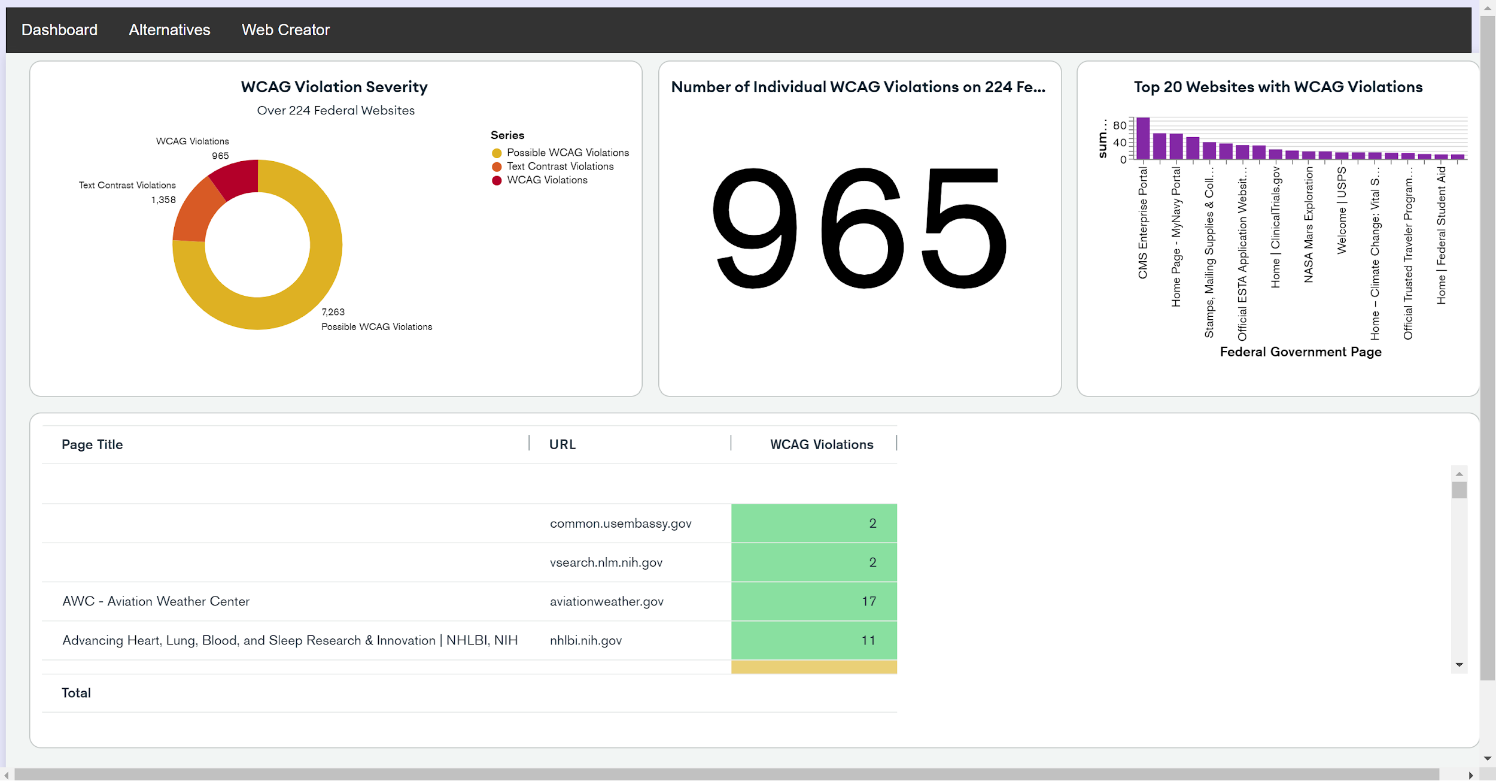
Notes:
Code Ada hackathon was hosted in October
Our project was a database that ranked websites based on accessibility according to the WAVE API, an API that runs WCAG analysis on a document
Provided recommendations for more accessible website—for ex. noaa.gov < https://radar.weather.gov/

Slide 4
Milestones
Phase I
Phase II
Phase III
Created a database and dashboard for website accessibility statistics
Expand database and create an interface for providing accessible website recommendations
Use web scraping to create a bare-bones version of inaccessible websites that is functional
Notes:
Phase 1:
The WAVE API is an API that utilizes the Web Content Accessibility Guidelines (WCAG) to evaluate websites’ accessibility for disabled users. We created a database of 224 commonly used federal websites and found 965 individual WCAG violations; interestingly, we found websites with similar functionalities but differences in their accessibility. Our goal is to develop a program that provides alternatives to inaccessible websites based on our database of WCAG features. We want users to be able to pick a certain function they want a website to perform (e.g. provide information about weather) and be given the most accessible website to use. We would also like to add features allowing users to filter websites based on certain accessibility needs that they have.
Phase 2:
Our long-term goal is to create a tool that automates adding WCAG features to websites. Our API would scrape a website and then generate our own frontend version with image descriptions, arias, text contrast, and more. This would allow people with disabilities to access sites without waiting for a developer to improve the website.

Slide 5
Questions?
Notes:
What are existing projects/tools that are similar to what we are doing? (advice/anything we should add)
What is it like to use a screenreader regularly? What features are good for a website (above barebones accessibility)

